Slide 1
4 Most Exercises

Slide 2
Audience
Tailored this presentation to a technical audience
It will be more in detail than if it were a client meeting – in which I would case I would leave out the model details and focus on the so what?
Any technical bits would be set aside for a follow up meeting if required

Slide 3
Task 1: Agenda
Background
Data exploration, key features and points of interest
Modelling and thought process involved in this
What drives a sale?
What are the main drivers of profit?
Questions

Slide 4
Task 2: Agenda
Background
Data exploration, key features and points of interest
Kaplan-Meir method
Comparison of mortalities by age and gender
Open Discussion around the Gompertz model
Questions

Slide 5
Task 1: Background
Dataset contains insurance quote information
There were 2742 quotes that were used with a sales rate of 24%
These were used to build two ML algorithm pipelines

Slide 6
Task 1: Background
There are 821 rows which have null or “invalid” results in a number of columns, ended up dropping these columns as they were all linked in terms of number of missing values and it as such it didn’t make sense to impute them
There were some non-disclosures and answers which were clearly “wrong”
There was no date information which would have been interesting to look at considering data drift

Slide 7
Task 1: Points of interest
All three sales channels, CTM, Direct and MSM had very similar sales rates
Currently there is a negative trend between premium and sales rate
Age has a very slight downwards trend with respect to sales rate

Slide 8
Task 1: Sweetviz Demo
Sweetviz is a great EDA library and screenshots can only do so much to showcase, worth noting that although not shown arguably its best use case is comparing between train/test datasets or two sources of data
https://pypi.org/project/sweetviz/
4most/assignment/data/reports/sweetviz_report.html

Slide 9
Task 1: The Modelling
Focussed on the pipelined approach to an ML problem
Test F1 score peaked at 0.80 for the full data with dropped columns
It was possible to push this to mid/high 80s by removing those rows

Slide 10
Task 1: Why Pipelines?
Re-usable
Trackable
Easily Understood

Slide 11
Task 1: Why AutoML?
Can be cloud based or local
Low code implementations
Easily Understood

Slide 12
Key drivers of a sale:
Months since last CCJ
Total Premium
JF Score
Term
Number of people not same surname at current address

Slide 13
Task 1: Main Drivers of profit
Profit is defined as the gross commission if a policy is sold
Since commission is directly correlated with premium there are two ways to increase profit
Increase number of sales, Increase Premium of those sales

Slide 14
Any Questions?

Slide 15
Task 2: Agenda
Background
Data exploration, key features and points of interest
Kaplan-Meir method
Comparison of mortalities by age and gender
Open Discussion around the Gompertz model
Questions

Slide 16
Task 2: Background
There are 14889 rows of paired data for joint last-survivor annuities
The data contains the age and sex of each person
The data contains the date of death if applicable

Slide 17
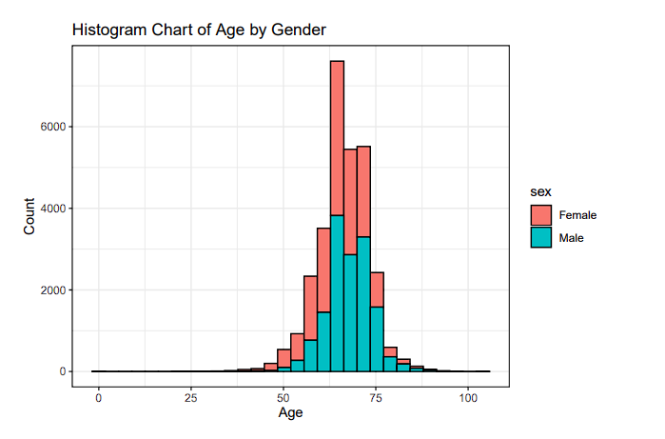
Age by Gender
Males are slightly older on average than females

Slide 18
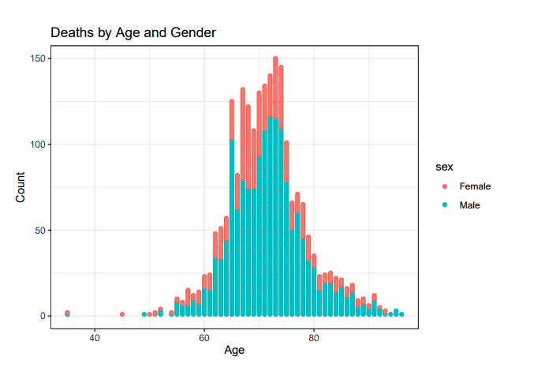
Deaths by Age and Gender
There are a lot more deaths in the male population

Slide 19
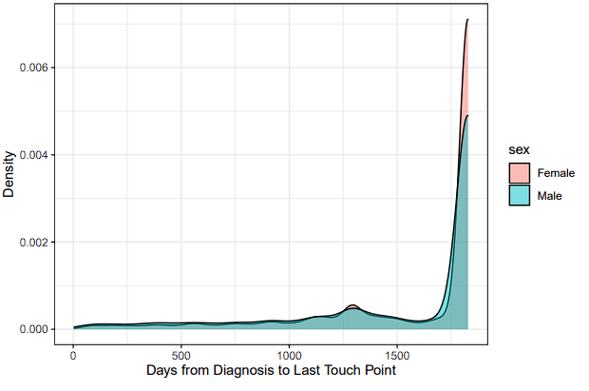
Last Touch Point Analysis
As age increases, proportion of females alive starts to be noticeably more than the males

Slide 20

Kaplan-Meier estimator
Used to estimate the survival function from lifetime data
Non-parametric, only uses time and death data
The estimator s hat can be denoted by:

Slide 21
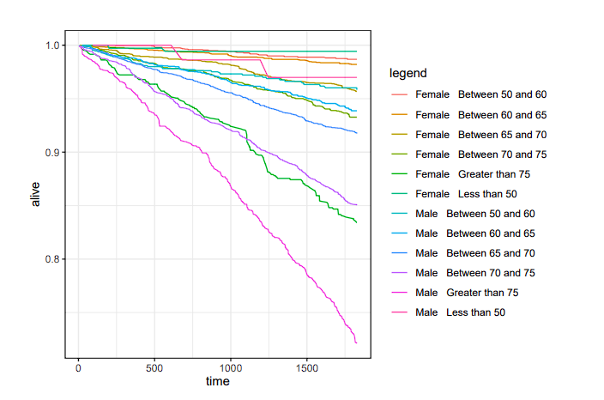
Mortalities by Age and Gender
Males have lower survival rates than females
Age has a big effect on survival rates

Slide 22


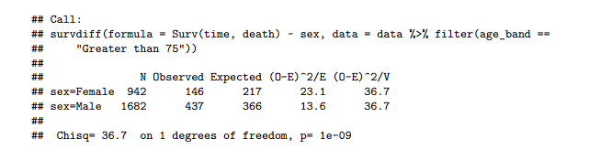
Statistical Significance of Survival Curves
Males have statistically significant survival curves to those of females
For whole population and for age bang groups

Slide 23
Any Questions?

